Slide 1
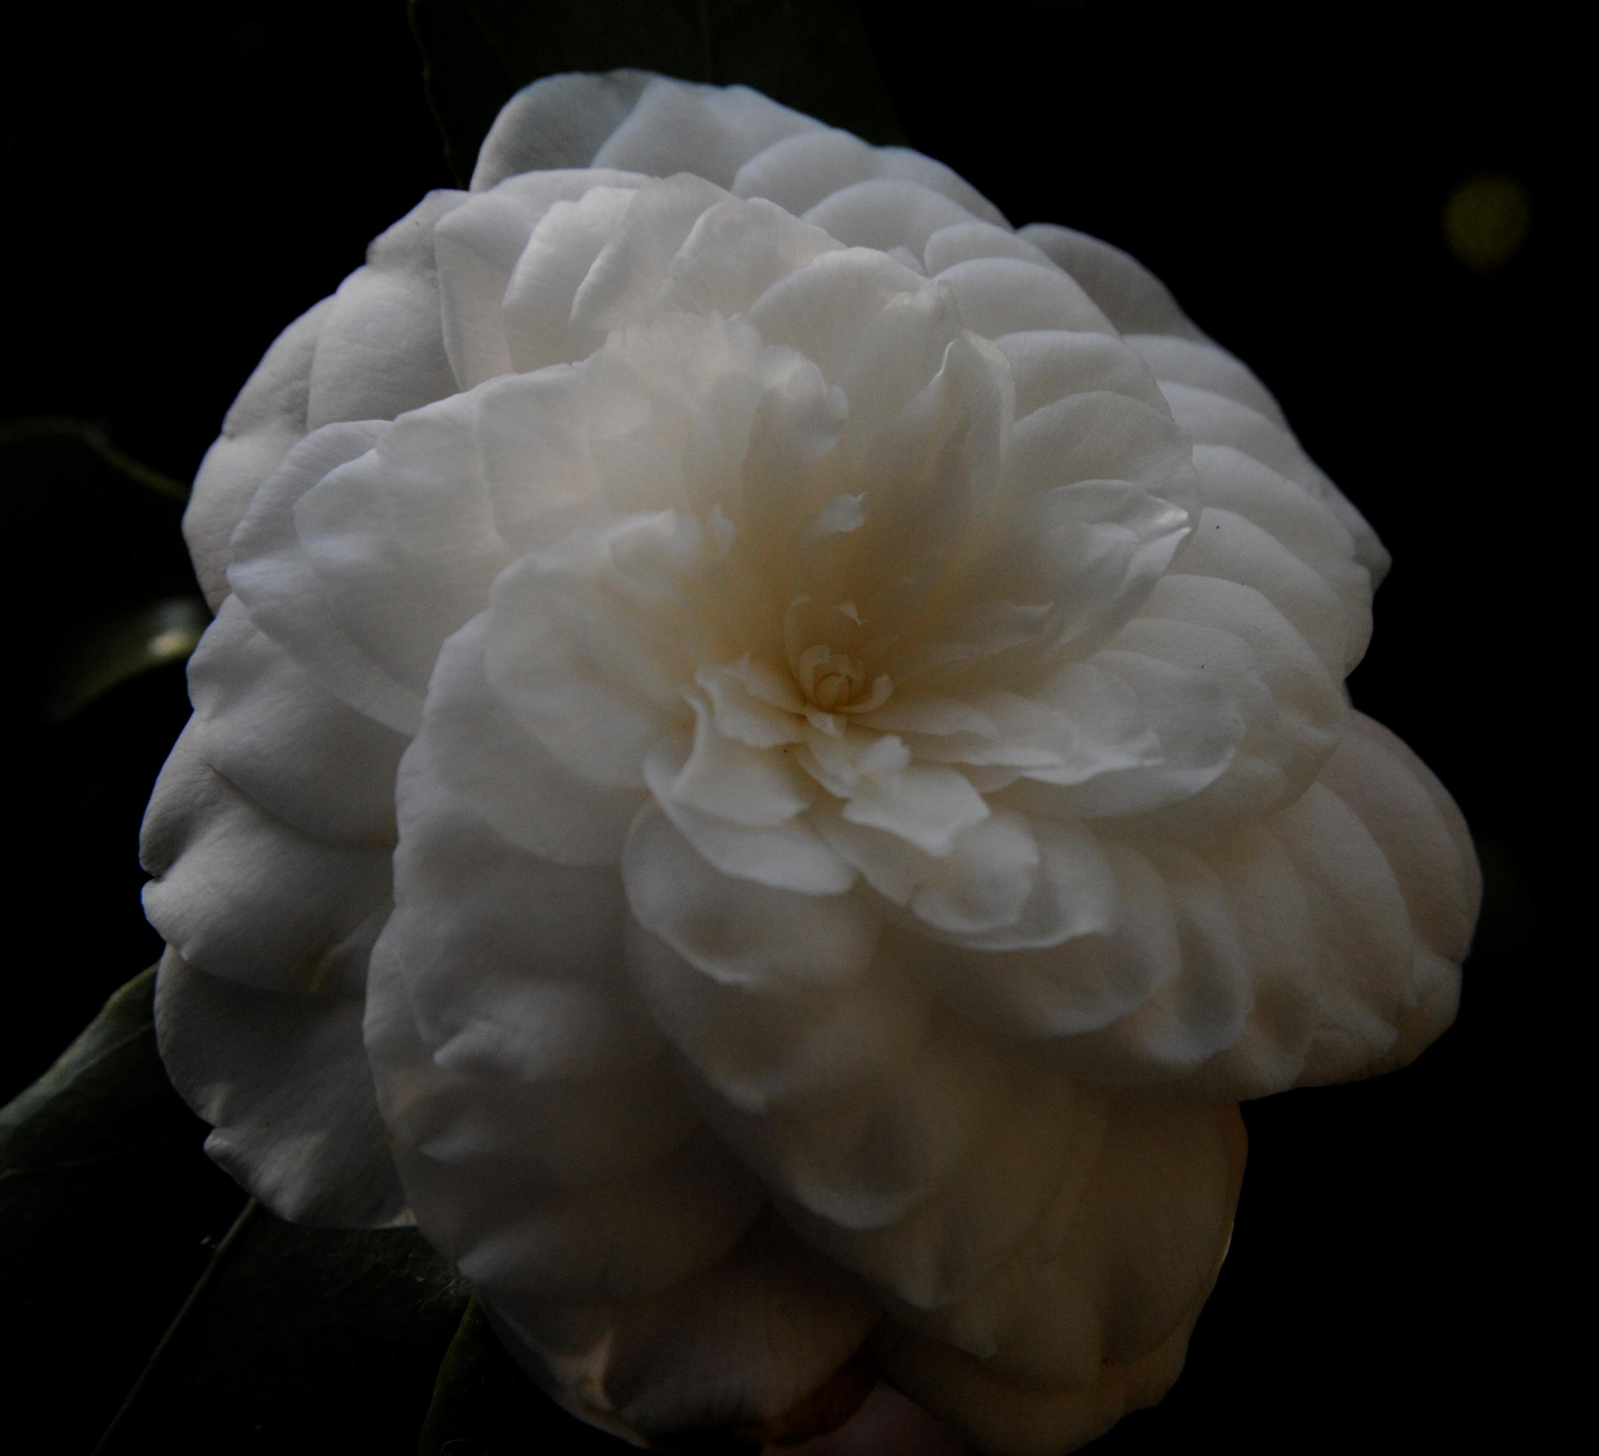
2022 ICS Congress Draft Program Pre-congress: Lucca & surroundings, Tuscany, Italy March 21 - 26 Congress: Verbania, Piedmont, Italy March 26 - 30 Post-congress: the 3 Lakes Orta (Italy), Locarno (Switzerland), Como (Italy) March 30 - April 2
Given the current COVID situation this presentation is a preliminary draft program that intends to illustrate the itinerary and dates of the Congress. A firm program will be published later, in Summer 2021

Slide 2
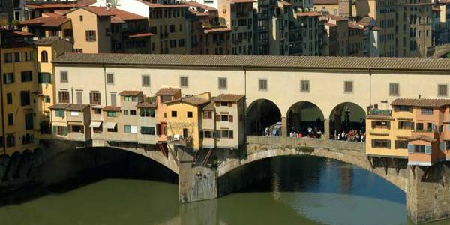
Pre-Congress: Tuscany
Pre-congress
Congress
Post-Congress
March 21: Transfer to Lucca
Transfer from Malpensa airport
Stop in Pisa
Reception at Hotel Guinigi, Lucca
Welcome buffet
March 22: Florence
Boboli garden
Lunch in Florence
Uffizi & Pontevecchio

Slide 3
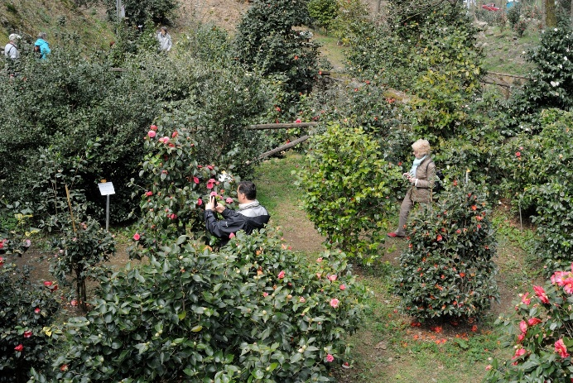
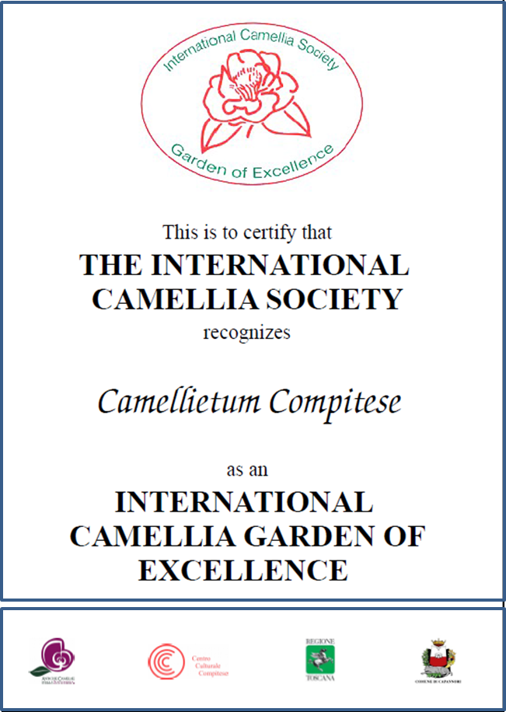
Pre-Congress: Tuscany
Pre-congress
Congress
Post-Congress
March 23: Lucca Villas
Villa Reale
Lunch at Villa Reale
Villa Oliva
March 24: Compito
Camellietum (Camellia Garden of Excellence)
Villa Borrini
Villa Orsi
La Chiusa
Camellia Show
Villa Reale, Marlia
Camellietum

Slide 4
Pre-Congress: Tuscany
Pre-congress
Congress
Post-Congress
March 25 Pescaglia & Lucca
Pescaglia: Puccini Theater and Menghini’s Garden
Visit Lucca walls
Puccini Recital in Lucca (Villa Bottini)
Farewell Dinner
March 26: Genova
Departure
Villa Durazzo Pallavicini (Genova)
Transfer to Malpensa and Pallanza (Congress)
Lucca walls
Villa Pallavicini

Slide 5
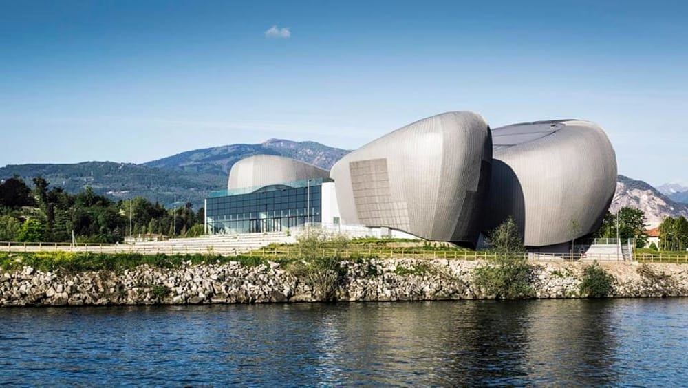
Congress: Verbania
Pre-congress
Congress
Post-Congress
«Il Maggiore» - the venue of the Congress
Verbania
March 26:
Transfer from Malpensa to Verbania
Reception and Reception & registration
Welcome dinner at Teatro Il Maggiore

Slide 6
Congress: Verbania
Pre-congress
Congress
Post-Congress
Hotel Majestic, Pallanza
March 27
Verbania Camellia Show
Borromeo Islands (RHS Partner Garden)
Isola Bella
Maggiore Theater, Pallanza

Slide 7
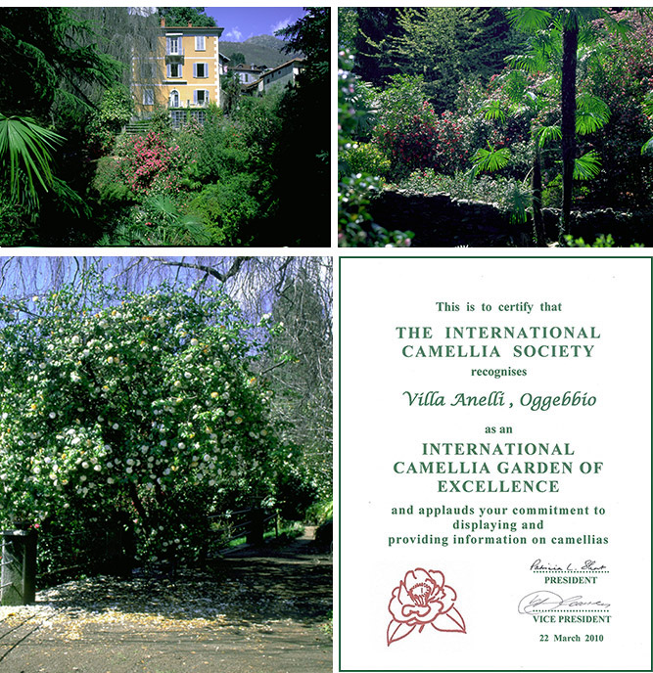
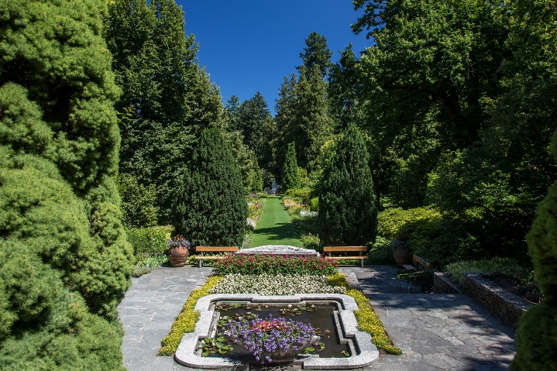
Congress: Verbania
Villa Rusconi-Clerici
Pre-congress
Congress
Post-Congress
March 28:
Morning: Paper Session
Villa Rusconi
Villa Taranto
March 29:
Morning/afternoon: Paper session
Visits: Villa Anelli (Camellia Garden of Excellence) or Villa San Remigio
Gala Dinner
March 30: transfer to Malpensa
Villa Anelli
Villa Taranto
Villa San Remigio

Slide 8
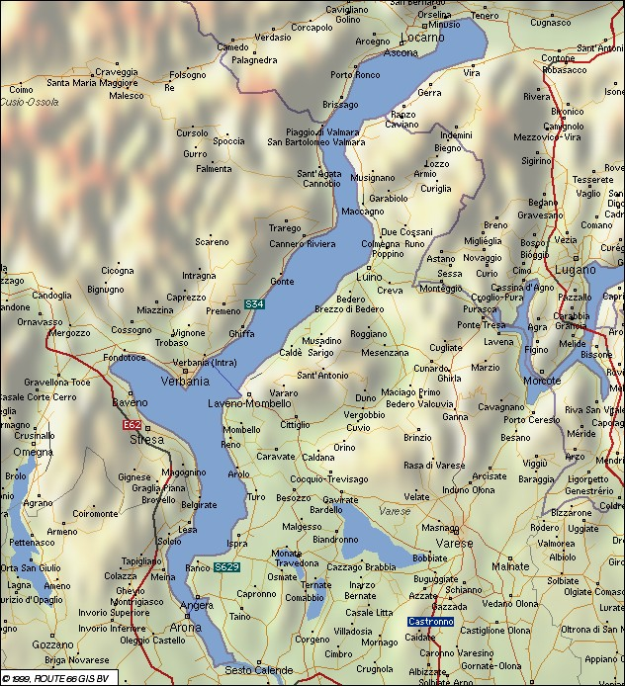
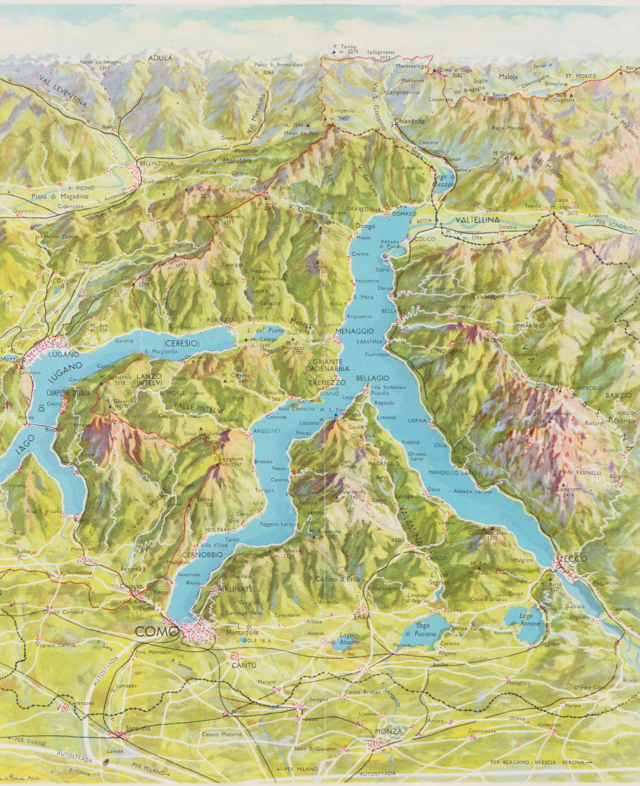
LOCARNO
VILLA CARLOTTA
CERNOBBIO
BELLAGIO
ORTA
POST-CONGRESS PART 1
ORTA AND SWITZERLAND
POST-CONGRESS PART 2
COMO LAKE

Slide 9
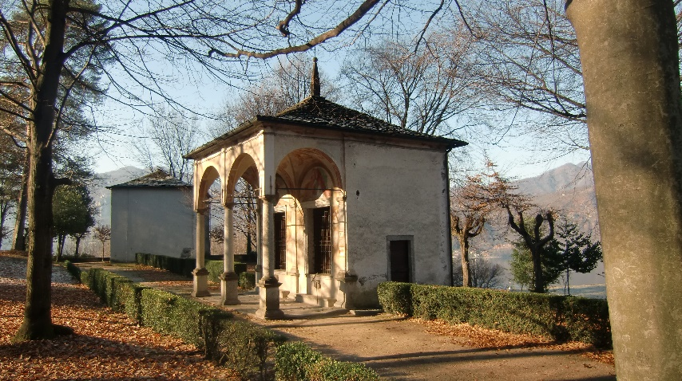
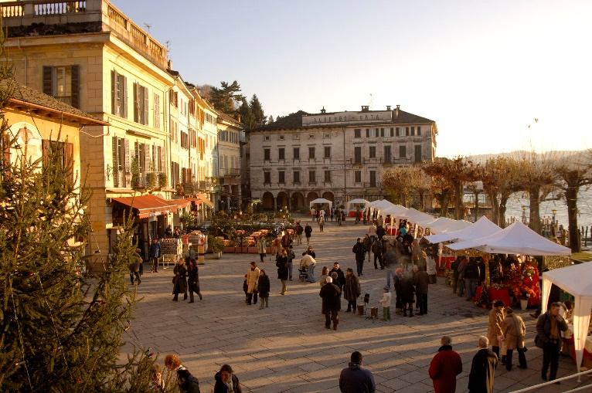
Post-Congress: Orta Lake
Pre-congress
Congress
Post-Congress
March 30: Orta
Transfer from Verbania
Visit Isola San Giulio (boat)
Lunch in Piazza Motta
Visit Villa Motta (Camellia Garden of Excellence) or “Sacro Monte”(World Heritage Site)
Welcome dinner
Villa Motta
Isola San Giulio
Sacro Monte
Piazza Motta

Slide 10
Post-Congress: LakeMaggiore - Locarno
Pre-congress
Congress
Post-Congress
March 31: Locarno (Switzerland)
Transfer to Locarno
Visit Parco delle Camelie (Camellia Garden of Excellence)
Lunch in Locarno
Visit Gambarogno garden or Sir Smithers’s garden (up to 30 people)
Welcome dinner
Parco delle Camelie, Locarno
Gambarogno, Botanic Garden

Slide 11
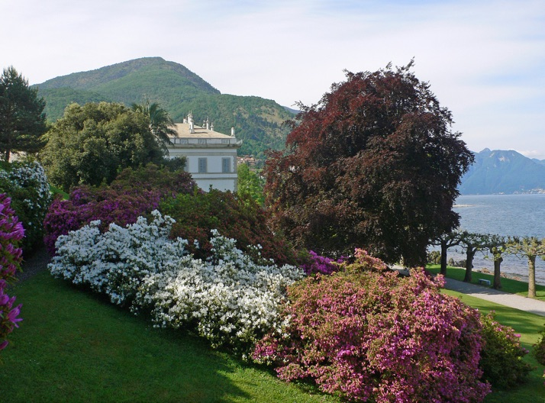
Post-Congress: Como Lake
Pre-congress
Congress
Post-Congress
April 1: Como Lake
Transfer to Como via Lugano
Lunch in Como
Visit Villa Carlotta (by boat)
Dinner in Cernobbio
Villa Melzi d’Eril
April 2:
Visit Villa Melzi by boat
Lunch
Transfer to Malpensa
Villa Carlotta *
*By Jean-Christophe BENOIST - Own work, CC BY 3.0, https://commons.wikimedia.org/w/index.php?curid=16407555

